Slide 1


Bernhard Eibegger
Michael Hausegger
Michael Kronberger
Mobile search for
employees

Slide 2
Motivation
On the go
  You must contact a specific person of a specific organisation
  You need exactly to know how to get to the place of your meeting.
    That starts in 5 minutes!

Slide 3
Solution in regards to contents
Develop smartphone application
that
  provides search functionality for persons
  supports most mobile operating systems
  has interactive maps
  let you contact persons immediately

Slide 4
Solution technically
Titanium Framework for mobile application development
Java EE/Spring HTML application holds data
REST-Webservice as
communication layer between

Slide 5
Titanium
Cross platform development framework for native smartphone applications
Based on XML and Javascript
Compiles developed code to target platform native code

Slide 6
Java EE / Spring application
Full fleged HTML frontend
Holds and manages data
Provides full text search functionality
via Rest webservice

Slide 7
REST webservices
Used for data exchange between Java EE / Spring and mobile application
Less overhead than SOAP webservices

Slide 8
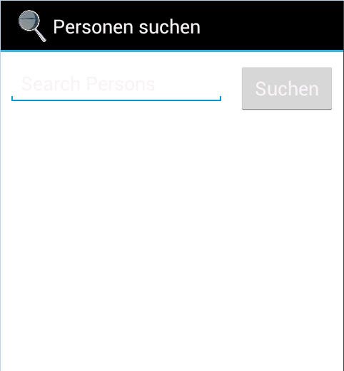
Start screen
Start screen with the preselection to search for employees
Search field is focused

Slide 9
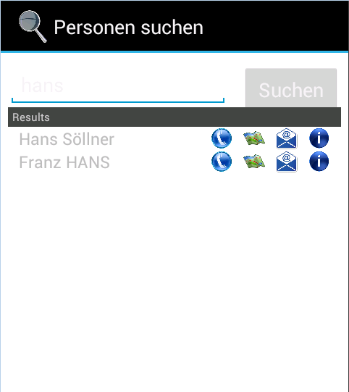
Search results
Short listing of results
Ability to directly
  call
  view map
  send email
  view aditional information

Slide 10
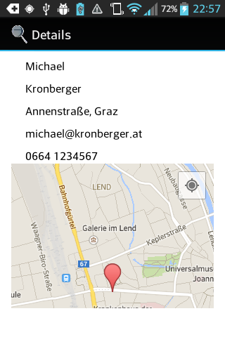
Details to person with interactive map
Phone number
E-mail address
Map with
  Interactive destination address
  Users current position

Slide 11
Thank you very much

